Slide 1
Programming Logic and Design Ninth Edition
Chapter 6
Arrays

Slide 2
Objectives
In this chapter, you will learn about:
Arrays
How an array can replace nested decisions
Using constants with arrays
Searching an array for an exact match
Using parallel arrays
Searching an array for a range match
Remaining within array bounds
Using a for loop to process arrays

Slide 3
Understanding Arrays
Array
A series or list of variables in computer memory
All variables share the same name, and must be the same data type
Each variable has a different subscript

Slide 4
How Arrays Occupy Computer Memory
Element: an item in the array
Array elements are contiguous in memory
Size of the array: the number of elements it will hold
Subscripts or indexes
Position number of an item in an array starting from 0 to one less than the number of elements in array
Subscripts are always a sequence of integers
Adding data values is called populating the array

Slide 5
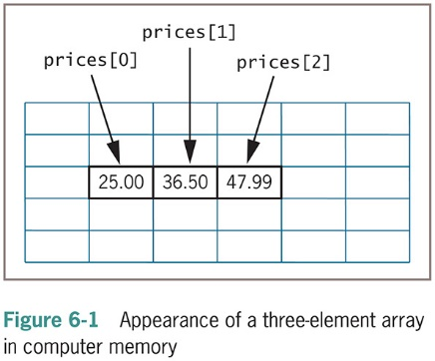
How Arrays Occupy Computer Memory (continued)
When programmers refer to array element prices[0], they say “prices sub 0” or simply “prices zero.”

Slide 6
Characteristics of Arrays
An array is a list of data items in contiguous memory locations
Each data item in an array is an element
Each array element is the same data type and the same size
Each element is differentiated from the others by a subscript, which is a whole number
Usable subscripts for an array range from 0 to one less than the number of elements in an array
Each array element can be used in the same way as a single item of the same data type

Slide 7
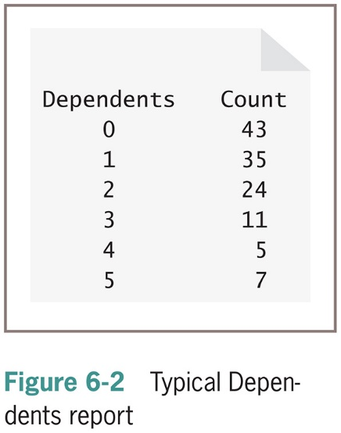
How an Array Can Replace Nested Decisions
Example: Human Resources Department Dependents report
List employees who have claimed zero through five dependents
Assume no employee has more than five dependents
Application produces counts for dependent categories
Uses a series of decisions
Application does not scale up to more dependents

Slide 8
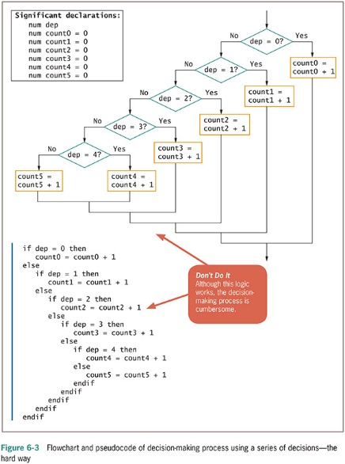
How an Array Can Replace Nested Decisions (continued -1)

Slide 9
How an Array Can Replace Nested Decisions (continued -2)
The array reduces the number of statements needed
Six dependent count accumulators are redefined as a single array
Variable as a subscript to the array
Array subscript variable must be:
Numeric with no decimal places
Initialized to 0
Incremented by 1 each time the logic passes through the loop

Slide 10
How an Array Can Replace Nested Decisions (continued -3)
The array reduces the number of statements needed
Six dependent count accumulators are redefined as a single array
Figure 6-2
Variable as a subscript to the array
Array subscript variable must be:
Numeric with no decimal places
Initialized to 0
Incremented by 1 each time the logic passes through the loop

Slide 11
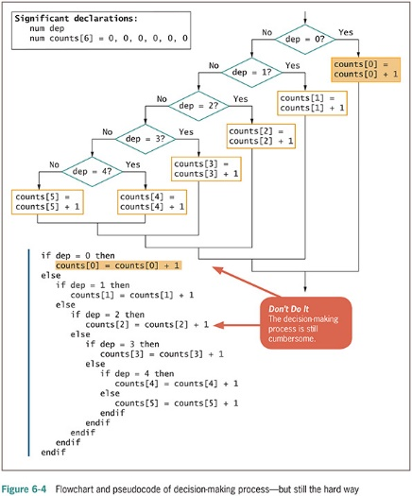
How an Array Can Replace Nested Decisions (continued -4)

Slide 12
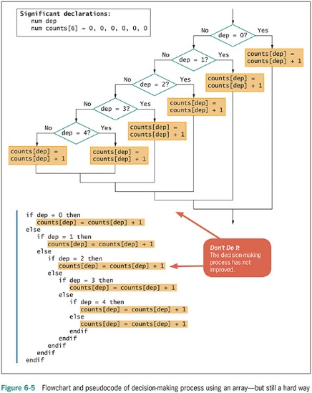
How an Array Can Replace Nested Decisions (continued -5)

Slide 13
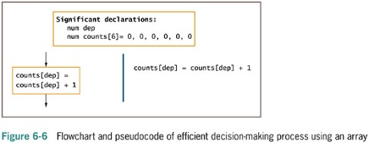
How an Array Can Replace Nested Decisions (continued -6)

Slide 14
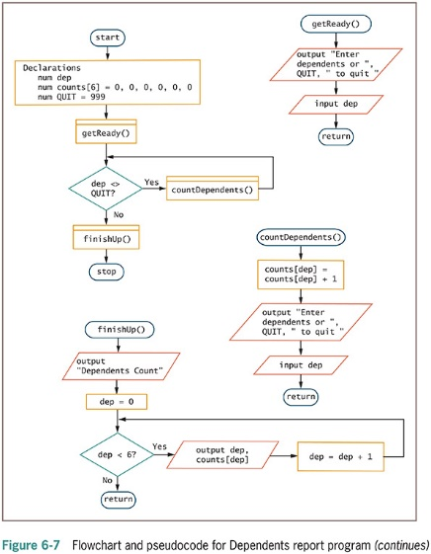
How an Array Can Replace Nested Decisions (continued -7)

Slide 15
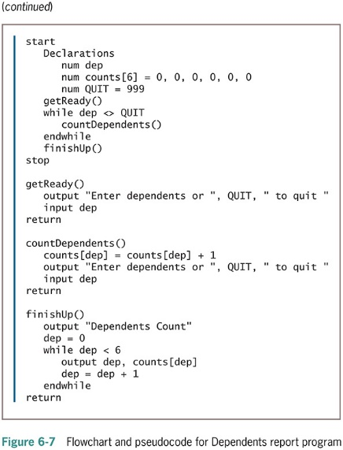
How an Array Can Replace Nested Decisions (continued -8)

Slide 16
Using Constants with Arrays
Use constants in several ways:
To hold the size of an array
As the array values
As subscripts

Slide 17
Using a Constant as the Size of an Array
Avoid “magic numbers” (unnamed constants)
Declare a named numeric constant to be used every time the array is accessed
Make sure any subscript remains less than the constant value
Constants are created automatically in many languages

Slide 18
Using Constants as Array Element Values
Sometimes the values stored in arrays should be constants
Example
string MONTH[12] = "January", "February", "March", "April", "May", "June", "July", "August", "September", "October", "November", "December"

Slide 19
Using a Constant as an Array Subscript
Use a numeric constant as a subscript to an array
Example
Declare a named constant as: num INDIANA = 5
Display value with:
output salesArray[INDIANA]

Slide 20
Searching an Array for an Exact Match
Sometimes you must search through an entire array to find a value – called a linear search
Example: mail-order business
Item numbers are three-digit, non-consecutive numbers
Customer orders an item; check if item number is valid
Create an array that holds valid item numbers
Search the array for an exact match

Slide 21
Searching an Array for an Exact Match (continued -1)
Flag: a variable that indicates whether an event occurred
Technique for searching an array
Set a subscript variable to 0 to start at the first element
Initialize a flag variable to false to indicate the desired value has not been found
Examine each element in the array
If the value matches, set the flag to True
If the value does not match, increment the subscript and examine the next array element

Slide 22
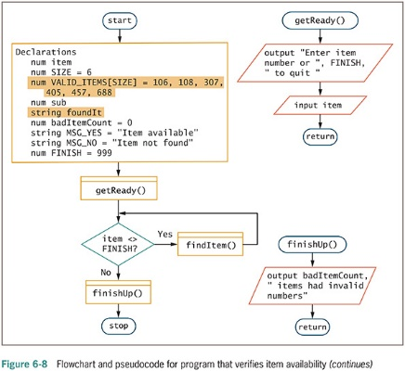
Searching an Array for an Exact Match (continued -2)

Slide 23
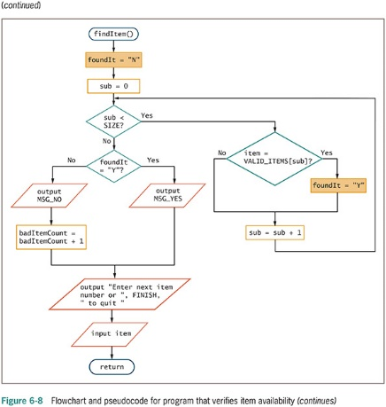
Searching an Array for an Exact Match (continued -3)

Slide 24
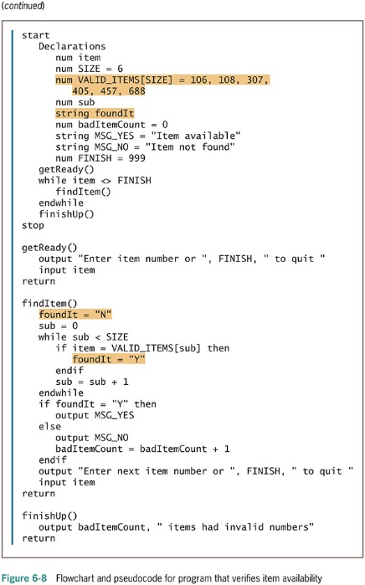
Searching an Array for an Exact Match (continued -4)

Slide 25
Using Parallel Arrays
Example: mail-order business
Two arrays, each with six elements
Valid item numbers
Valid item prices
Each price in the valid item price array is in the same position as the corresponding item in the valid item number array
Parallel arrays
Each element in one array is associated with an element in the same relative position in the other array
Look through the valid item array for the customer’s item
When a match is found, get the price from the item price array

Slide 26
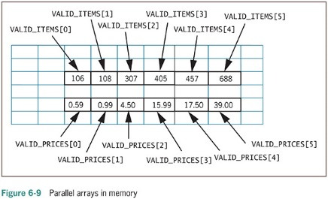
Using Parallel Arrays (continued -1)

Slide 27
Using Parallel Arrays (continued -2)
Use parallel arrays when:
Two or more arrays contain related data
A subscript relates the arrays
Elements at the same position in each array are logically related
Indirect relationship
Relationship between an item’s number and its price
Parallel arrays are very useful

Slide 28
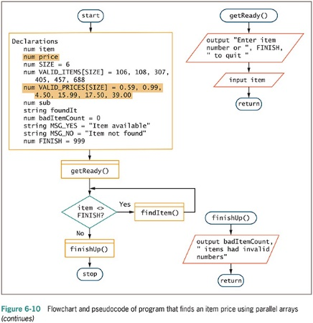
Using Parallel Arrays (continued -3)

Slide 29
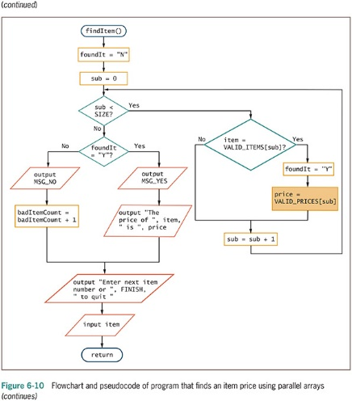
Using Parallel Arrays (continued -4)

Slide 30
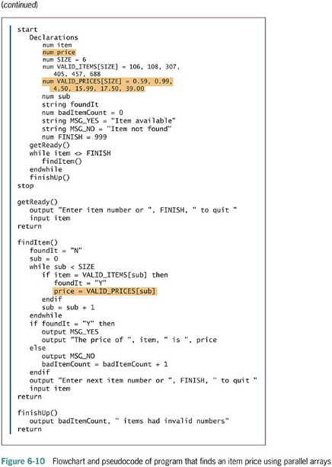
Using Parallel Arrays (continued -5)

Slide 31
Improving Search Efficiency
The program should stop searching the array when a match is found
Set a variable to a specific value instead of letting normal processing set it
Leaving a loop as soon as a match is found improves efficiency
The larger the array, the more beneficial it becomes to do an early exit

Slide 32
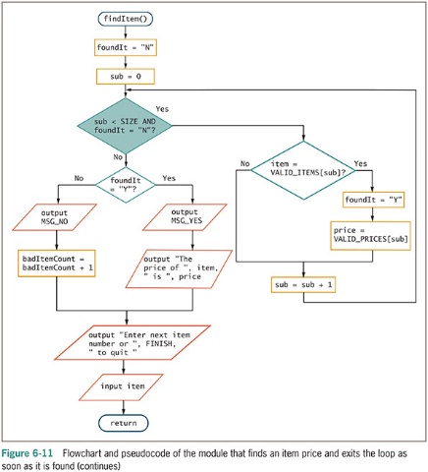
Improving Search Efficiency (continued -1)

Slide 33
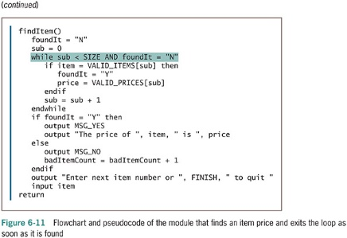
Improving Search Efficiency (continued -2)

Slide 34
Searching an Array for a Range Match
Programmers may want to work with ranges of values in arrays, 1 through 5 or 20 through 30
Example: mail-order business
Read the customer order data; determine the discount based on the quantity ordered
First approach
An array with as many elements as each possible order quantity
Store the appropriate discount for each possible order quantity

Slide 35
Searching an Array for a Range Match (continued -1)
Drawbacks of previous approach
Requires a very large array; uses a lot of memory
Stores the same value repeatedly
How do you know when you have enough elements?
Customer can always order more
Better approach
Create two parallel arrays, each with four elements
One array has the four discount rates
One array has the low end of each quantity range
Use a loop to make comparisons

Slide 36
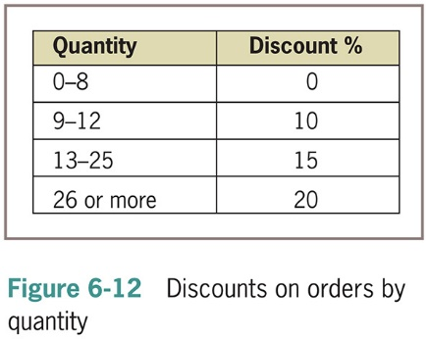
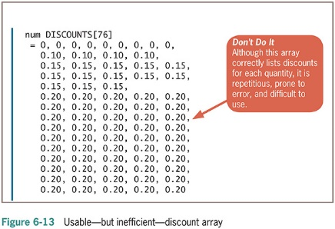
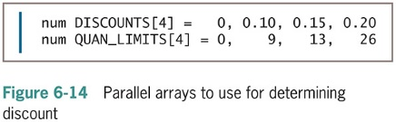
Searching an Array for a Range Match (continued -2)

Slide 37
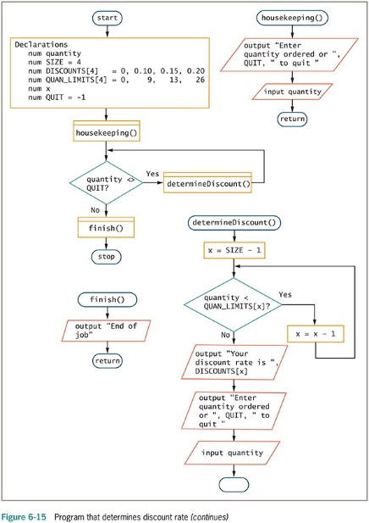
Searching an Array for a Range Match (continued -3)

Slide 38
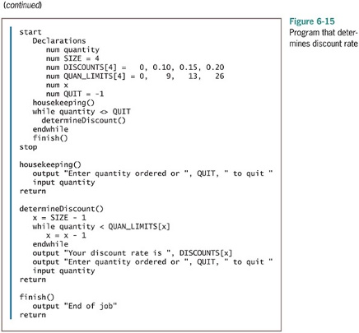
Searching an Array for a Range Match (continued -4)

Slide 39
Remaining within Array Bounds
Every array has a finite size
Number of elements in the array
Number of bytes in the array
Arrays are composed of elements of the same data type
Elements of the same data type occupy the same number of bytes in memory
The number of bytes in an array is always a multiple of the number of array elements
Access data using a subscript containing a value that accesses memory occupied by the array

Slide 40
Remaining within Array Bounds (continued -1)
In bounds: using a subscript that is within the acceptable range for the array
Out of bounds: using a subscript that is not within the acceptable range for the array
An invalid array subscript is a logical error
When an invalid subscript is used:
Some languages stop execution and issue an error
Other languages access a memory location outside of the array
The program should prevent bounds errors

Slide 41
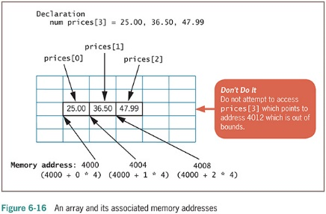
Remaining within Array Bounds (continued -2)

Slide 42
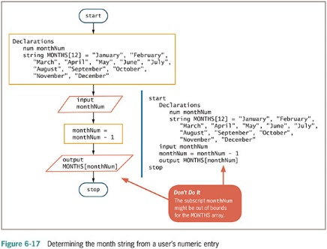
Remaining within Array Bounds (continued -3)

Slide 43
Remaining within Array Bounds (continued -4)
To improve a program, add a test to ensure the entered subscript is valid
If entered subscript is not valid:
Display an error message and end the program
Use a default value
Continuously reprompt the user for a new value until it is valid

Slide 44
Using a for Loop to Process an Array
for loop: a single statement
Initializes the loop control variable
Compares it to a limit
Alters it
The for loop is especially convenient when there is a need to process every element in the array
Must stay within array bounds
Highest usable subscript is one less than the array size

Slide 45
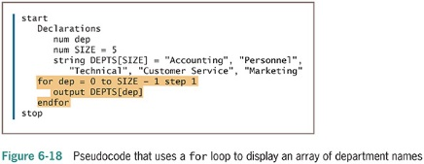
Using a for Loop to Process Arrays (continued -1)

Slide 46
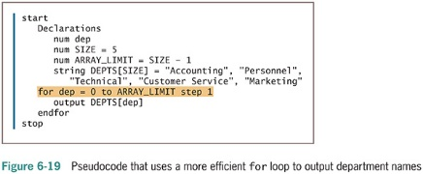
Using a for Loop to Process Arrays (continued -2)

Slide 47
Summary
Array: a named series or list of values in memory
Same data type
Different subscript
Use a variable as a subscript to the array to replace multiple nested decisions
Constants can be used to hold an array’s size
Searching through an array requires
Initializing a subscript
Using a loop to test each element
Setting a flag when a match is found

Slide 48
Summary (continued -1)
Parallel arrays: each element in one array is associated with the element in a second array
Elements in each array have the same relative position
For range comparisons, store either the low- or high-end value of each range

Slide 49
Summary (continued -2)
Access data in an array
Use a subscript containing a value that accesses memory within the array bounds
A subscript is out of bounds if it is not within the defined range of acceptable subscripts
The for loop is a convenient tool for working with arrays when processing each element of an array from beginning to end

